Slide 1

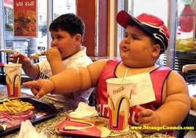



O t
Don’t go the wrong way
Go the right way
HEALTH STARTS AT HOME
BE THE EXAMPLE

